Slide 1
Personas

Slide 2

Template
Name
Age
Occupation
Location
Gender
Goals
Influences
Challenges/frustrations
Interests
Day in the life

Slide 3
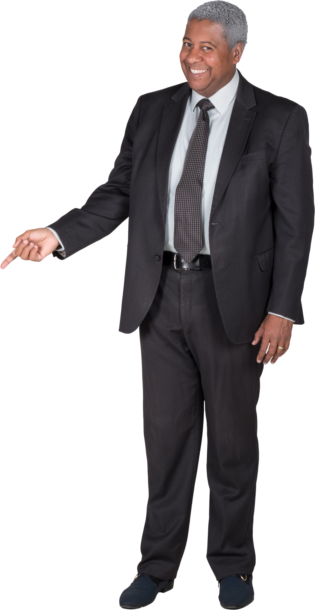
Gordon(Travelling foodie)
Age: 41
Gender: Male
Occupation: Lawyer
Goals: London
Influences:
Celebrity chefs – Gordon Ramsay, Jamie Oliver
Food bloggers and youtubers
Interests:
Going to new restaurants
Food and wine sampling
Food truck rallies
Food tourism
Cooking
Frustrations:
Semi tech illiterate
Always hungry
Lacks knowledge of niche food locations while travelling
As a proud supporter of small independent businesses, Gordon would want to help more small businesses.
Day in the life:
Gordon starts off weekends with a home-made full English breakfast. During the weekdays, he buys a sandwich in the gas station he passes every morning on the way to work. before leaving for work every morning. At lunch, he and his colleagues attempts to visit new restaurants. He will place a booking days in advanced if necessary to reserve a seat in the new restaurant across the street. Near the end of the day, he will go to the supermarket near his office and pick up fresh produce for dinner. Once dinner is finished, Gordon will put on some food related shows. He dreams about food every night.

Slide 4

Ron (4th year business major)
Name: Ronald Ferguson​
Age: 23​
Gender: Male​
Location: Glasgow, UK​
Goals: ​
To be able to better plan his daily schedules and know exactly how long he will have to spend on getting meals.
To discover new places to eat and get content for his food blog
Influences:
His family run a large convenient store chain, so he recognises the challenges small businesses face to attract a customer base.
Tired of the commercialisation of something as simple as food, wants there to be equal representation.
Challenges:
Currently available platforms only advertise big business chains which can afford that form of advertising. Doesn't represent a huge part of local businesses that aren't widely advertised but have promising quality of food.
Interests:​
A massive foodie, loves cooking just as much as he loves exploring new cuisines.​
Maintains his own food blog, reviewing and recommending local take-out places.​
Day in the Life:​
Busy as a bee. Barely has any free time during an average day due to his studies and part-time job.​
Often ends up skipping lunch as he is too busy to travel all the way back home or to the nearest café that he knows of.

Slide 5
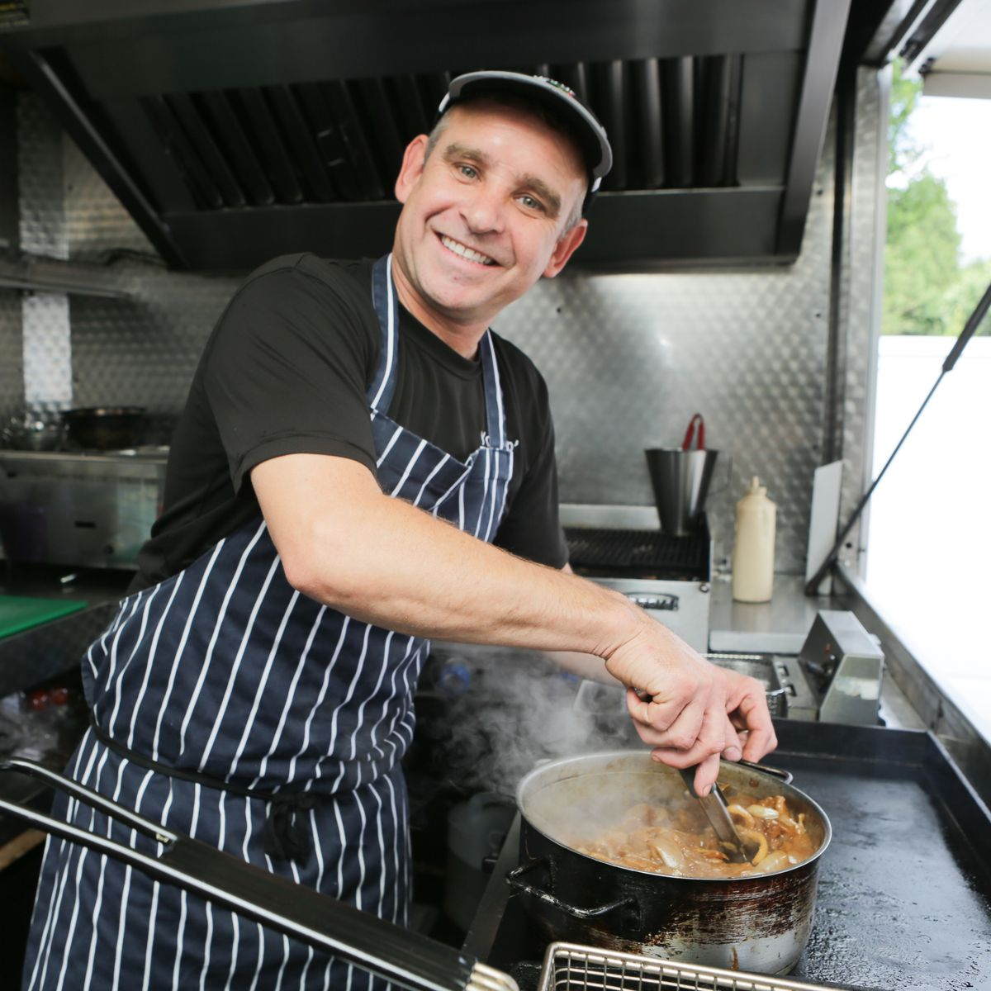
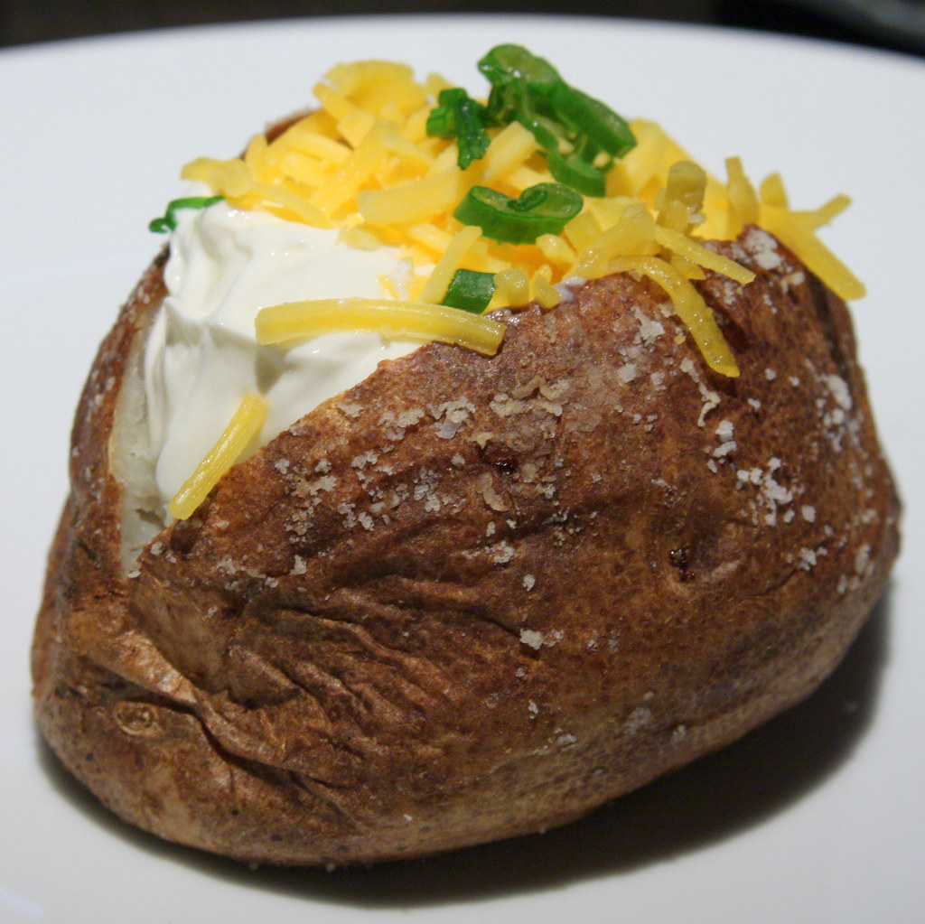
Jim -(Owner of The Flying Spud)
AGE:
55
GENDER:
Male
LOCATION:
West Pitkerro Industrial Estate, Dundee
GOALS:
To get his food van more recognized on the internet
Gain more first-time customers
INFLUENCES:
Gordon Ramsay
Street Food
CHALLENGES:
Finds internet advertising confusing
Struggles to get new customers to find The Flying Spud
DAY IN LIFE:
Jim gets to the van at 6am to prep food for breakfast and the day ahead. He serves hungry workers from 7am to 7pm every day by himself as the owner/manager.
INTERESTS:
Travelling, Sport, Independent food establishments

Slide 6
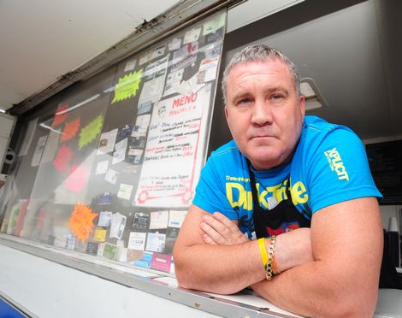
Barry Owner of Culloden Catering
Age: 45 years old
Gender: Male
Location: near Inverness (on the A9)
Goals: Sell more food
...by having more exposure and customers
Have a larger consistent customer base
Influences: wants to be a successful small business owner
Challenges: Advertising is expensive
Location is remote, most people unaware of the van
Not always in the same place, not all customers are aware of the new location
Interests: Cooking
Football
Drinking pints with his mate
Day in the life: wakes up at 6:00am and gets to the burger van 6:45am, preps food until the customers start to line up for breakfast, continues to server food till 4:30pm and decides whether to move the van to different location for the next day

Slide 7
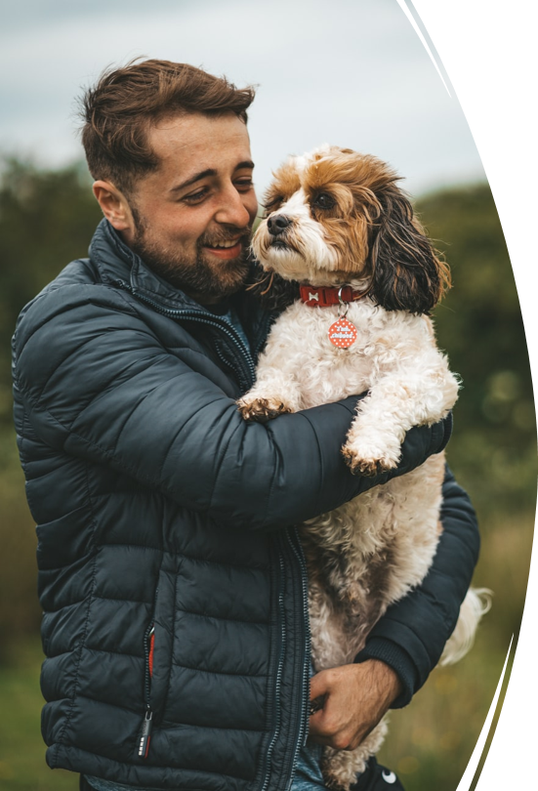
About:
Name - Jhon
Age - 28 years old
Location - Glasgow
Gender – Male
Goal:
Wants to get promoted
Be efficient at work
Interests:
Spending free time with the dog
Eat delicious food
Influences:
Get a promotion
Challenges:
John wants to get a promotion, but you can't be late for work for that. Because he spends all morning walking with his beloved dog, he doesn’t have time to cook breakfast.
Day in the life:
John wakes up at 7:00. Spends 30 minutes to wash and gather. Then he spends about 40 minutes walking the dog. He doesn't like to eat snacks, so he takes a new route to work to find an interesting place to eat. By 9:00 he comes to work, but this time he is hungry because he hasn't found anything.

Slide 8
User stories

Slide 9
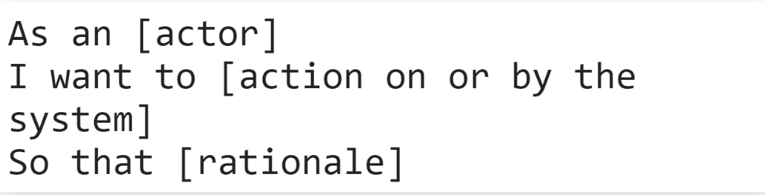
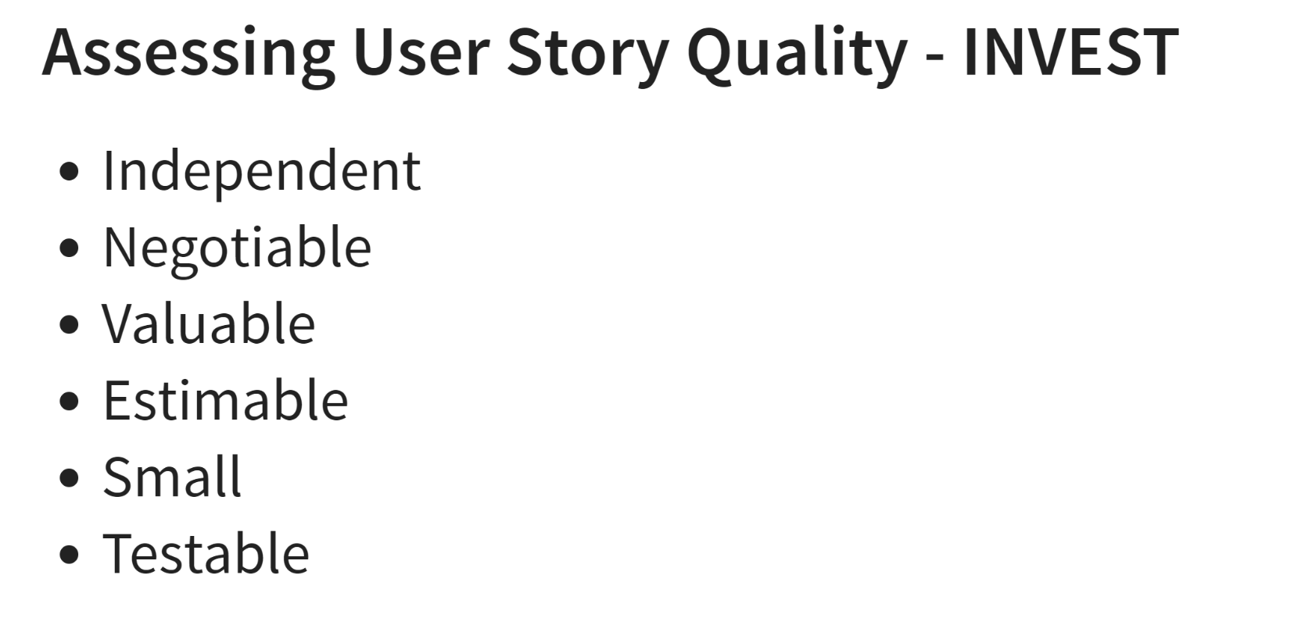
Template

Slide 10
Barry's user story
I want a service than can display the location of the van to a new customer base as well as the offering on the menu that day
Ideally a simple app or website where I don't need much computer know how to use and I can send a message out to all regular and nearby customers if there is a price-drop, or a special meal deal is available
My van moves to different location so it would be great if I could update the location and let customers know what times the van is open

Slide 11
Ronald's User Story
As a student with a busy schedule, I want to find locations closest to me on a map where I could get a quick meal, so I don’t have to waste time travelling long distances and I can plan ahead as to how long it will take me to get to the location and back.
As a student living on a budget, I would also like to find locations with the best possible offers/student discounts, so I can stay within my weekly budgets and not go overboard getting small meals.
As a food reviewer and an avid foodie, I would like to know what a restaurant/roll van has to offer without actually having to go there, so I can decide whether a place has what I am looking for.

Slide 12

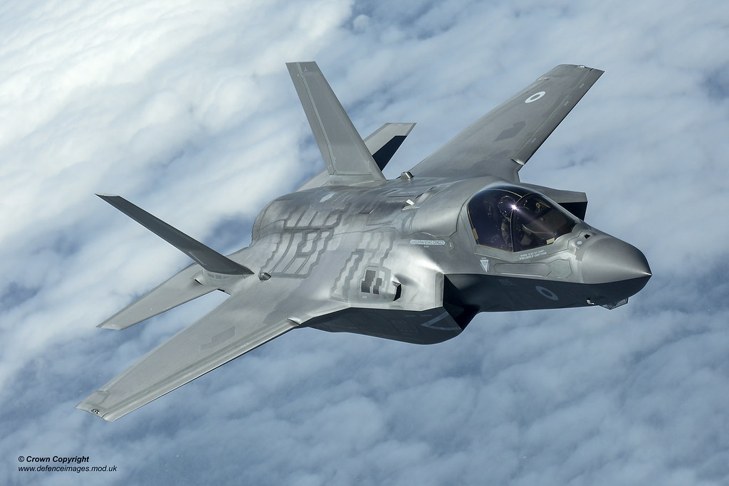
Jim's User Story
As a small independent business owner, I would like to be noticed on the internet and be able to promote my business to try and compete with the major vendors. I would like to be able to create a profile for my business displaying my location on the map, a description, opening times etc.
A mobile app that will be easy to access and use, for users looking for some 'scran' in their area will allow me to be noticed.
I'd love to send out notifications to people's phones advertising special offers I have on.
I would like this app to be easy to learn as personally I am not very tech savvy.

Slide 13
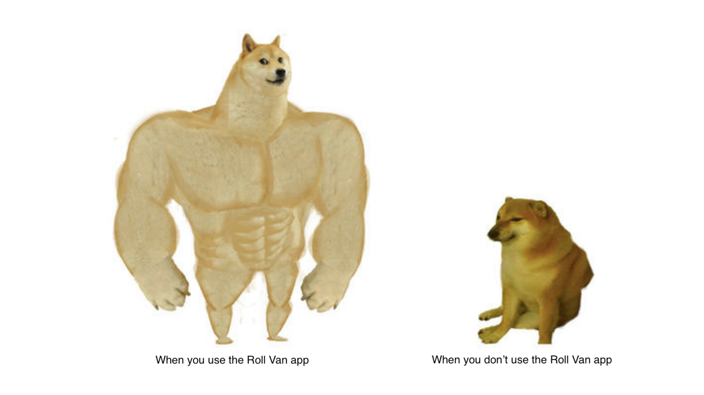
Jhons's user story
As a food lover, I want to see the locations of food vans in order to get the most optimal route to work.
Since I love trying new dishes, I want to be notified about special offers, because there may be an offer in which I am interested.
Since I can't be late for work, I would like to see the menu while I go to the van, to come up already knowing what I want to order.
Since I get up very early, it is important for me to know the opening time so that I don't come to a place that hasn't yet opened

Slide 14
Gordon's user stories
As a commuter, I want to be notified of nearby food vans so I can grab a breakfast roll there instead of a gas station sandwich.
As a traveller, I want to be able to find restaurants from small independent businesses since I have already tried all the food from food franchises.
As a foodie, I don't want to be recommended the same restaurant as I prefer trying new things.
Preference in order:
Favourited
Unvisited
Highest rated
Closeness
Cuisine

